Slide 1
Control Systems (CS)
Lecture-3
Block Diagram Representation of Control Systems

Slide 2
Outline
Introduction
Canonical Form
Reduction of complicated Block diagrams
Examples of Block Diagram

Slide 3
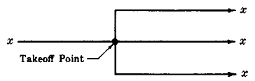
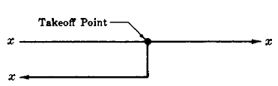







Introduction
A Block Diagram is a shorthand pictorial representation of the cause-and-effect relationship of a system.
For the operations of addition and subtraction the block becomes a small circle, called a summing point.
$$y$$
$$+$$
$$x$$
$$+$$
$$x+y−z$$
$$−$$
$$z$$
In order to have the same signal or variable be an input to more than one block or summing point, a takeoff point is used.

Slide 4
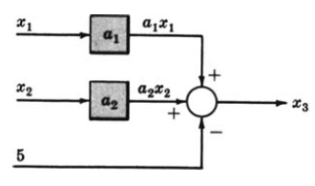

Example-1
Consider the following equations in which $x_{1}$, $x_{2}$, $x_{3}$, are variables, and $a_{1}$, $a_{2}$ are general coefficients or mathematical operators.

Slide 5
Example-2
Draw the Block Diagrams of the following equations.

Slide 6
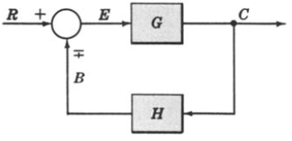
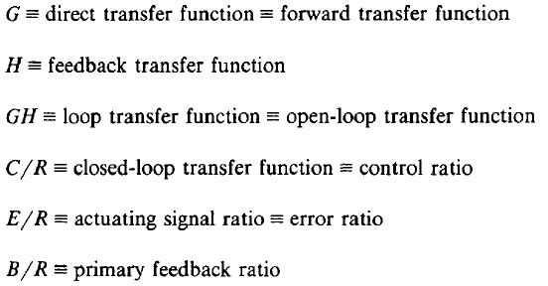



Canonical Form of A Feedback Control System

Slide 7
Characteristic Equation
The control ratio is the closed loop transfer function of the system.
The denominator of closed loop transfer function determines the characteristic equation of the system.
Which is determined as:

Slide 8
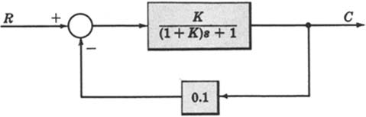
Example-3
Open loop transfer function
Feed Forward Transfer function
control ratio
feedback ratio
error ratio
closed loop transfer function
characteristic equation
closed loop poles and zeros if K=10.

Slide 9
Reduction of Complicated Block Diagrams
The block diagram of a practical control system is often quite complicated.
It may include several feedback or feedforward loops, and multiple inputs.
By means of systematic block diagram reduction, every multiple loop linear feedback system may be reduced to canonical form.

Slide 10
Reduction techniques
1. Combining blocks in cascade
2. Combining blocks in parallel

Slide 11
Reduction techniques
3. Moving a summing point behind a block
4. Moving a summing point ahead of a block

Slide 12
5. Moving a pickoff point behind a block
6. Moving a pickoff point ahead of a block

Slide 13
7. Eliminating a feedback loop
8. Swap with two neighboring summing points

Slide 14
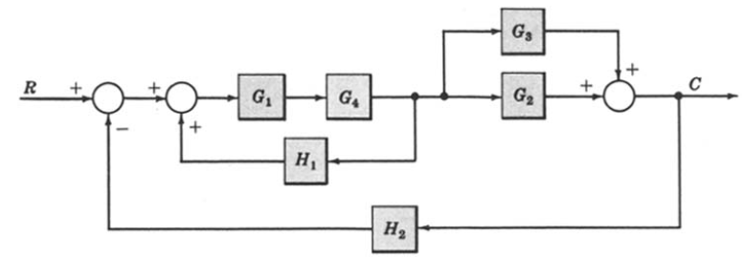
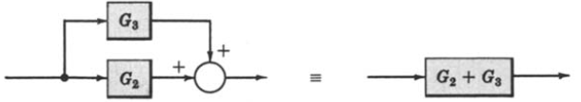
Example-4: Reduce the Block Diagram to Canonical Form.
Combine all cascade block using rule-1
Combine all parallel block using rule-2

Slide 15


Example-4: Reduce the Block Diagram to Canonical Form.
$$G_{2}+G_{3}$$
$$G_{1}G_{4}$$

Slide 16
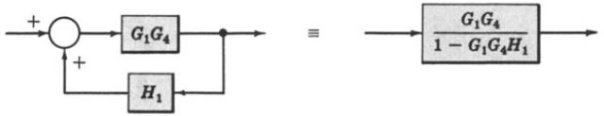
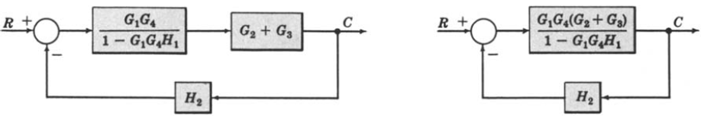
Example-4: Continue.
Eliminate all minor feedback loops using rule-7
After the elimination of minor feedback loop the block diagram is reduced to as shown below
Again blocks are in cascade are removed using rule-1

Slide 17
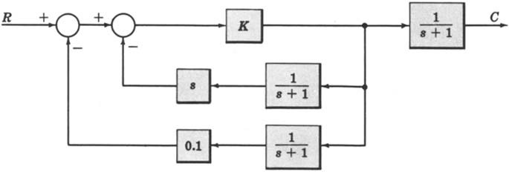
Example-5 (Home Work)
For the system represented by the following block diagram determine:
Open loop transfer function
Feed Forward Transfer function
control ratio
feedback ratio
error ratio
closed loop transfer function
characteristic equation
closed loop poles and zeros if K=100.

Slide 18
Example-6
_
+
_
+
+
+

Slide 19
Example-6
_
+
+
+
_
+

Slide 20
Example-6
_
+
+
+
_
+

Slide 21
Example-6
_
+
_
+
+
+

Slide 22
Example-6
_
+
_
+

Slide 23
Example-6
_
+
_
+

Slide 24
Example-6
+
_

Slide 25
Example 7
Find the transfer function of the following block diagram
R
(
s
)

Slide 26
Solution:
1. Moving pickoff point A ahead of block
2. Eliminate loop I & simplify

Slide 27
3. Moving pickoff point B behind block

Slide 28
4. Eliminate loop III

Slide 29
Example 8 (class work)
Find the transfer function of the following block diagrams

Slide 30
Solution:
1. Eliminate loop I
2. Moving pickoff point A behind block
Not a feedback loop

Slide 31
3. Eliminate loop II

Slide 32
Example 9
Find the transfer function of the following block diagrams

Slide 33
Solution:
1. Moving pickoff point A behind block

Slide 34
2. Eliminate loop I and Simplify
feedback
Not feedback

Slide 35
3. Eliminate loop II & IIII

Slide 36
Example 10 (Home Work)
Find the transfer function of the following block diagrams

Slide 37
Solution:
1. Moving pickoff point A behind block

Slide 38
2. Eliminate loop I & Simplify

Slide 39
3. Eliminate loop II

Slide 40
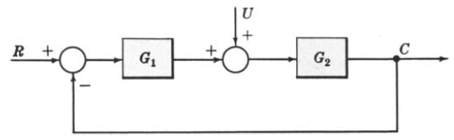

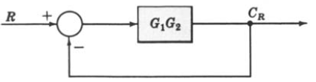
Example-11: Multiple Input System. Determine the output C due to inputs R and U using the Superposition Method.

Slide 41
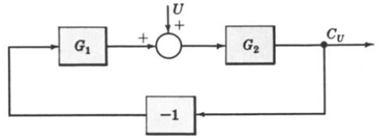
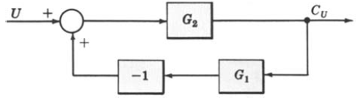
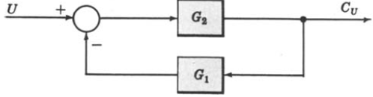
Example-11: Continue.

Slide 42


Example-11: Continue.

Slide 43
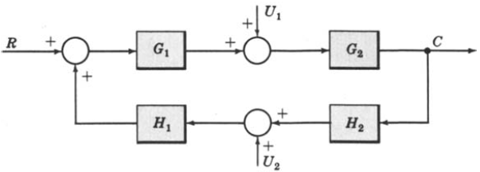
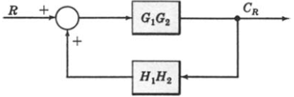
Example-12: Multiple-Input System. Determine the output C due to inputs R, U1 and U2 using the Superposition Method.

Slide 44
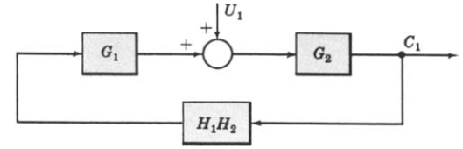
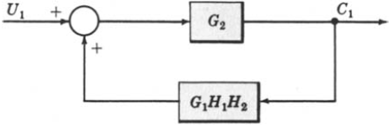
Example-12: Continue.

Slide 45
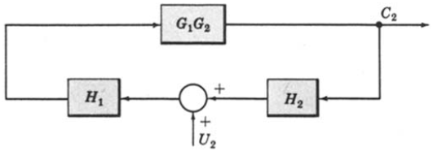
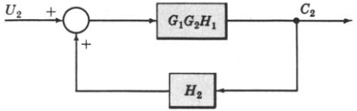

Example-12: Continue.

Slide 46
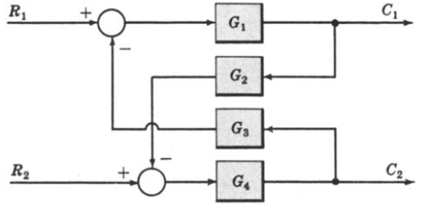
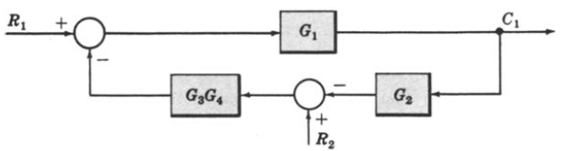
Example-13: Multi-Input Multi-Output System. Determine C1 and C2 due to R1 and R2.

Slide 47
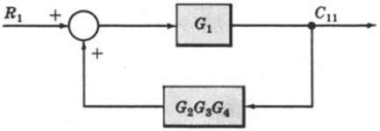
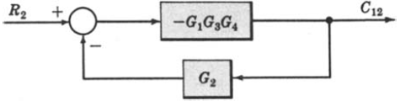
Example-13: Continue.

Slide 48
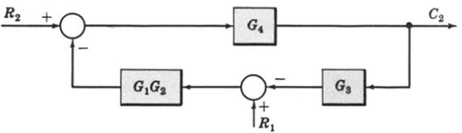
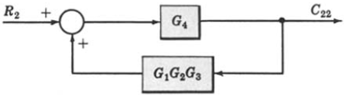
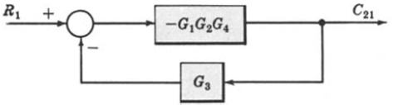
Example-13: Continue.
When R1 = 0,
When R2 = 0,

Slide 49
Block Diagram of Armature Controlled D.C Motor
R_{a}
L_{a}
c
i_{a}
V_{a}
e_{b}
T
J
ω
V_{f}=constant

Slide 50
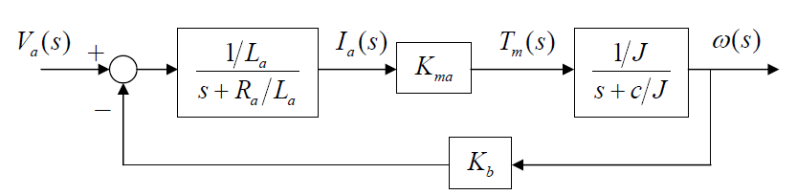
Block Diagram of Armature Controlled D.C Motor

Slide 51
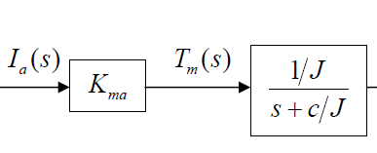

Block Diagram of Armature Controlled D.C Motor

Slide 52
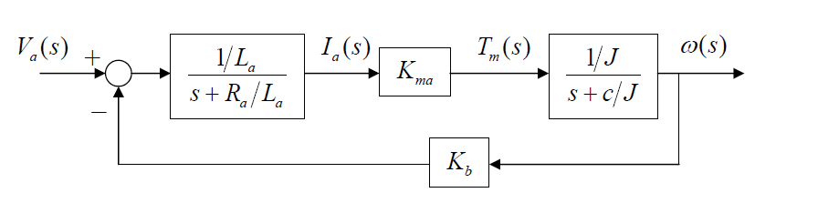
Block Diagram of Armature Controlled D.C Motor

Slide 53



Block Diagram Angular Position Control System
R_{a}
L_{a}
N₁
+
k_{p}
₋
J_{M} B_{M}
+
+
+
B_{L}
i_{a}
T
e
e_{a}
e_{b}
θ
J_{L}
r
c
_
_
_
N₂
i_{f} = Constant

Slide 54
Introduction
Alternative method to block diagram representation, developed by Samuel Jefferson Mason.
Advantage: the availability of a flow graph gain formula, also called Mason’s gain formula.
A signal-flow graph consists of a network in which nodes are connected by directed branches.
It depicts the flow of signals from one point of a system to another and gives the relationships among the signals.

Slide 55
Fundamentals of Signal Flow Graphs
Consider a simple equation below and draw its signal flow graph:
The signal flow graph of the equation is shown below;
Every variable in a signal flow graph is represented by a Node.
Every transmission function in a signal flow graph is represented by a Branch.
Branches are always unidirectional.
The arrow in the branch denotes the direction of the signal flow.

Slide 56
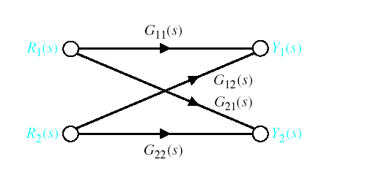




Signal-Flow Graph Models
$$R_{1}(s)$$
$$Y_{1}(s)$$
$$R_{2}(s)$$
$$Y_{2}(s)$$

Slide 57
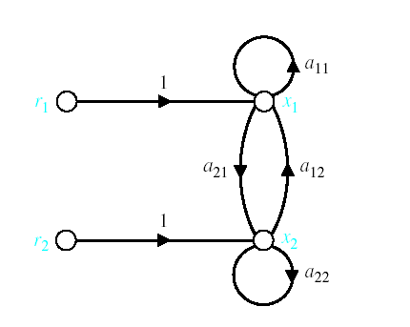




Signal-Flow Graph Models
r₁ and r₂ are inputs and x₁ and x₂ are outputs
$$r_{1}$$
$$x_{1}$$
$$r_{2}$$
$$x_{1}$$

Slide 58
Signal-Flow Graph Models
x_{o} is input and x₄ is output
f
c
x₀
x₁
x₂
g
x₃
x₄
a
d
h
b
e

Slide 59
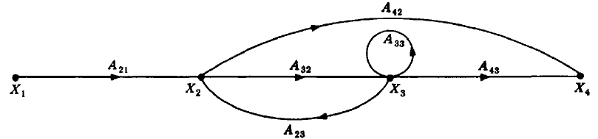
Terminologies
An input node or source contain only the outgoing branches. i.e., X₁
An output node or sink contain only the incoming branches. i.e., X₄
A path is a continuous, unidirectional succession of branches along which no node is passed more than ones. i.e.,
A forward path is a path from the input node to the output node. i.e.,
X₁ to X₂ to X₃ to X₄ , and X₁ to X₂ to X₄ , are forward paths.
A feedback path or feedback loop is a path which originates and terminates on the same node. i.e.; X₂ to X₃ and back to X₂ is a feedback path.
X₁ to X₂ to X₃ to X₄
X₁ to X₂ to X₄
X₂ to X₃ to X₄

Slide 60
Terminologies
A self-loop is a feedback loop consisting of a single branch. i.e.; A₃₃ is a self loop.
The gain of a branch is the transmission function of that branch.
The path gain is the product of branch gains encountered in traversing a path. i.e. the gain of forwards path X₁ to X₂ to X₃ to X₄ is A₂₁A₃₂A₄₃
The loop gain is the product of the branch gains of the loop. i.e., the loop gain of the feedback loop from X₂ to X₃ and back to X₂ is A₃₂A_{23.}
Two loops, paths, or loop and a path are said to be non-touching if they have no nodes in common.

Slide 61
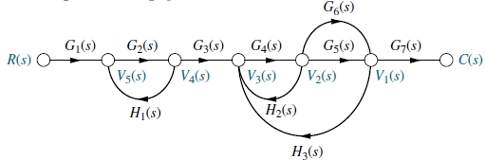
Consider the signal flow graph below and identify the following
Input node.
Output node.
Forward paths.
Feedback paths (loops).
Determine the loop gains of the feedback loops.
Determine the path gains of the forward paths.
Non-touching loops

Slide 62

Consider the signal flow graph below and identify the following
There are two forward path gains;

Slide 63
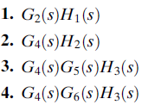
Consider the signal flow graph below and identify the following
There are four loops

Slide 64

Consider the signal flow graph below and identify the following
Nontouching loop gains;

Slide 65
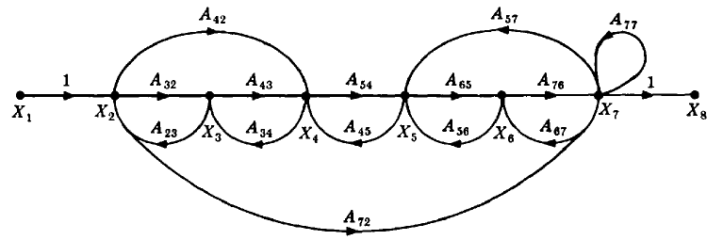
Consider the signal flow graph below and identify the following
Input node.
Output node.
Forward paths.
Feedback paths.
Self loop.
Determine the loop gains of the feedback loops.
Determine the path gains of the forward paths.

Slide 66
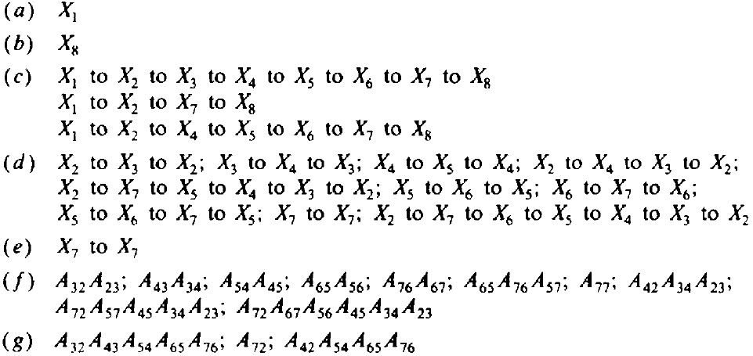
Input and output Nodes
Input node
Output node

Slide 67
(c) Forward Paths

Slide 68
(d) Feedback Paths or Loops

Slide 69
(d) Feedback Paths or Loops

Slide 70
(d) Feedback Paths or Loops

Slide 71
(d) Feedback Paths or Loops

Slide 72
(e) Self Loop(s)

Slide 73
(f) Loop Gains of the Feedback Loops

Slide 74
(g) Path Gains of the Forward Paths

Slide 75
Mason’s Rule (Mason, 1953)
The block diagram reduction technique requires successive application of fundamental relationships in order to arrive at the system transfer function.
On the other hand, Mason’s rule for reducing a signal-flow graph to a single transfer function requires the application of one formula.
The formula was derived by S. J. Mason when he related the signal-flow graph to the simultaneous equations that can be written from the graph.

Slide 76
Mason’s Rule:
The transfer function, C(s)/R(s), of a system represented by a signal-flow graph is;
Where
n = number of forward paths.
P_{i} = the i ^{th} forward-path gain.
∆ = Determinant of the system
∆_{i} = Determinant of the i^{th} forward path
∆ is called the signal flow graph determinant or characteristic function. Since ∆=0 is the system characteristic equation.

Slide 77
Mason’s Rule:
∆ = 1- (sum of all individual loop gains) + (sum of the products of the gains of all possible two loops that do not touch each other) – (sum of the products of the gains of all possible three loops that do not touch each other) + … and so forth with sums of higher number of non-touching loop gains
∆_{i} = value of Δ for the part of the block diagram that does not touch the i-th forward path (Δ_{i} = 1 if there are no non-touching loops to the i-th path.)

Slide 78
Systematic approach
Calculate forward path gain P_{i} for each forward path i.
Calculate all loop transfer functions
Consider non-touching loops 2 at a time
Consider non-touching loops 3 at a time
etc
Calculate Δ from steps 2,3,4 and 5
Calculate Δ_{i} as portion of Δ not touching forward path i

Slide 79
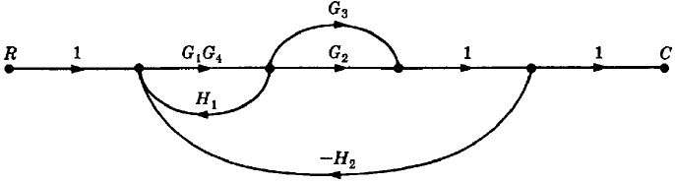

Example#1: Apply Mason’s Rule to calculate the transfer function of the system represented by following Signal Flow Graph
Therefore,
There are three feedback loops

Slide 80
Example#1: Apply Mason’s Rule to calculate the transfer function of the system represented by following Signal Flow Graph
There are no non-touching loops, therefore
∆ = 1- (sum of all individual loop gains)

Slide 81
Example#1: Apply Mason’s Rule to calculate the transfer function of the system represented by following Signal Flow Graph
Eliminate forward path-1
∆₁ = 1- (sum of all individual loop gains)+...
∆₁ = 1
Eliminate forward path-2
∆₂ = 1- (sum of all individual loop gains)+...
∆₂ = 1

Slide 82


Example#1: Continue

Slide 83
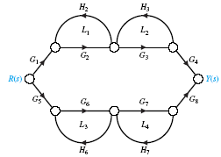
Example#2: Apply Mason’s Rule to calculate the transfer function of the system represented by following Signal Flow Graph
P₁
P₂
1. Calculate forward path gains for each forward path.
2. Calculate all loop gains.
3. Consider two non-touching loops.
L₁L₃ L₁L₄
L₂L₄ L₂L₃

Slide 84
Example#2: continue
Consider three non-touching loops.
None.
Calculate Δ from steps 2,3,4.

Slide 85
Example#2: continue
Eliminate forward path-1
Eliminate forward path-2

Slide 86
Example#2: continue

Slide 87
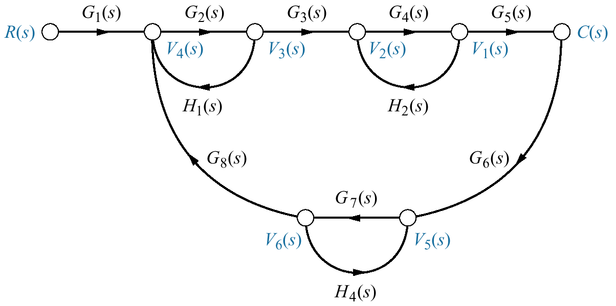
Example#3
Find the transfer function, C(s)/R(s), for the signal-flow graph in figure below.

Slide 88

Example#3
There is only one forward Path.

Slide 89
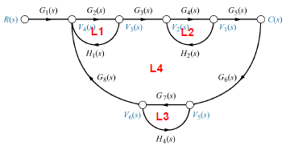

Example#3
There are four feedback loops.

Slide 90

Example#3
Non-touching loops taken two at a time.

Slide 91
Example#3
Non-touching loops taken three at a time.

Slide 92
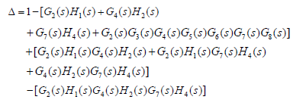
Example#3
Eliminate forward path-1

Slide 93
Example#4: Apply Mason’s Rule to calculate the transfer function of the system represented by following Signal Flow Graph
There are three forward paths, therefore n=3.

Slide 94
Example#4: Forward Paths

Slide 95
Example#4: Loop Gains of the Feedback Loops

Slide 96
Example#4: two non-touching loops

Slide 97
Example#4: Three non-touching loops

Slide 98
From Block Diagram to Signal-Flow Graph Models Example#5
H₁
R(s)
E(s)
X₁
－
X₃
C(s)
G₁
G₂
G₃
G₄
－
X₂
－
H₂
H₃
－H₁
R(s)
1
E(s)
G₁
X₁
G₂
X₂
G₃
X₃
G₄
C(s)
－H₂
－H₃

Slide 99
From Block Diagram to Signal-Flow Graph Models Example#5
－H₁
R(s)
1
E(s)
G₁
X₁
G₂
X₂
G₃
G₄
X₃
1
C(s)
－H₂
－H₃

Slide 100
Example#6
－
X₁
Y₁
－
G₁
R(s)
E(s)
+
+
C(s)
－
－
+
X₂
G₂
－
Y₂
-1
X₁
G₁
Y₁
-1
1
R(s)
E(s)
-1
C(s)
1
1
1
1
X₂
G₂
Y₂
-1
-1

Slide 101
Example#6
-1
X₁
G₁
Y₁
-1
1
R(s)
1
E(s)
-1
C(s)
1
X₂
1
Y₂
1
G₂
-1
-1
7 loops:
3 ‘2 non-touching loops’ :

Slide 102
Example#6
-1
X₁
G₁
Y₁
-1
1
R(s)
1
E(s)
-1
C(s)
1
X₂
1
Y₂
1
G₂
-1
-1
Then:
4 forward paths:

Slide 103
Example#6
We have

Slide 104
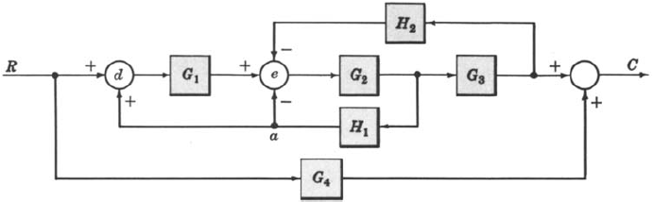
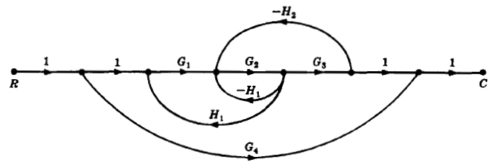

Example-7: Determine the transfer function C/R for the block diagram below by signal flow graph techniques.
The signal flow graph of the above block diagram is shown below.
There are two forward paths. The path gains are
The three feedback loop gains are
No loops are non-touching, hence
Because the loops touch the nodes of P1, hence
Hence the control ratio T = C/R is
Since no loops touch the nodes of P2, therefore

Slide 105
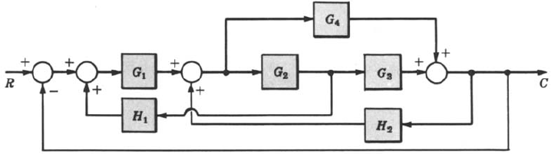
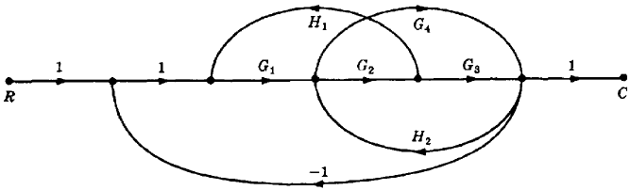

Example-6: Find the control ratio C/R for the system given below.
The signal flow graph is shown in the figure.
The two forward path gains are
The five feedback loop gains are
There are no non-touching loops, hence
All feedback loops touches the two forward paths, hence
Hence the control ratio T =

Slide 106
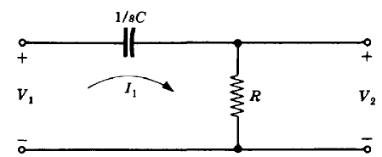
Design Example#1

Slide 107



Design Example#2

Slide 108

Design Example#2

Slide 109

Design Example#2

